Slide 1
Introducing Diversity to gPool
Marianne Arriola
And
Ashley Bruce

Slide 2
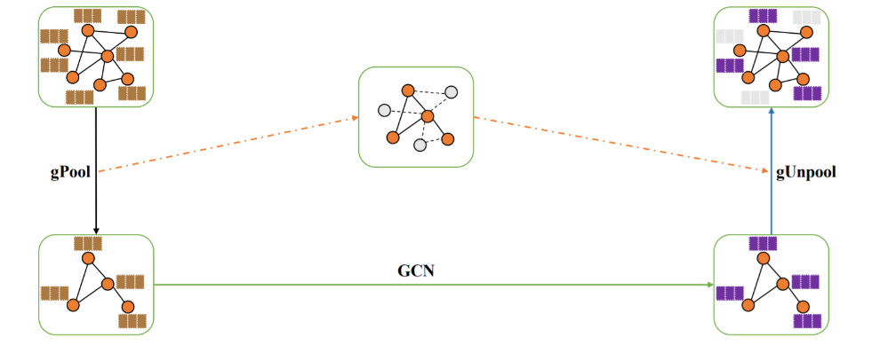
Background
Graph U-Nets
Encoder-decoder model on graphs
Notes:
Marianne
High level feature encoding-decoding for generating network embeddings for graph learning tasks
Does representation learning for graph data
Encoder-decoder architecture for graphs that creates a smaller graph
Goal: create smaller graph that preserves information (sparsify) for high-level feature encoding and decoding to network embedding
Quickly introduce gpool
Explain how it ranks nodes
Maintaining heterogeneity in network emb

Slide 3
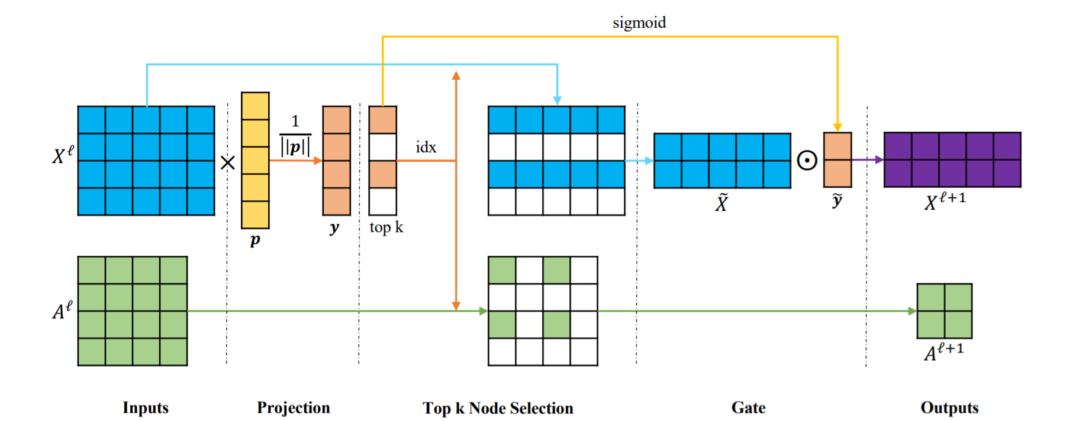
Background
Graph U-Nets
Selects nodes based on a trainable projection vector to form a smaller graph
Does not consider node heterogeneity
Notes:
Marianne
Does representation learning for graph data
Encoder-decoder architecture for graphs that creates a smaller graph
Goal: create smaller graph that preserves information (sparsify) for feature encoding
Quickly introduce gpool
Explain how it ranks nodes
Maintaining heterogeneity in network emb

Slide 4
Approach
Account for diversity using the Jaccard coefficient
Measures similarity in neighborhoods between 2 nodes
Compare performance
Pooling using projection vector
Pooling using Jaccard coefficient rankings
Pooling using projection vector AND Jaccard coefficient rankings
Notes:
Marianne
Cut to how we use diversity

Slide 5
Current progress
Replicated original results
Implemented Jaccard coefficient as measure for diversity
Replaced algorithm for top-k with top JC
Items only being selected for their JC performance
Merged diversity with top-k
Incorporated JC into edge weights for selection in top-k
Ran experiments on PROTEINS dataset with the following results
Notes:
Ashley
Replicate to also get the timing

Slide 6
Results
PROTEINS
# Epochs | gPool with Projection | gPool with Jaccard (Ours) | gPool with Projection + Jaccard (Ours)
1 | 73.214% | 60.714% | 74.107%
10 | 74.107% | 75% | 75.893%
50 | 75.893% | 76.786% | 76.786%
Notes:
Ashley
We only ran experiments up to 50 epochs for the time being
Due to how long it took to complete more than 50 epochs
gPool with the projection and jaccard performed better than just the projection across all epochs on this dataset
We can see here too that just using the Jaccard for 50 epochs gives us the same accuracy as using the projection and the Jaccard
We believe this is because of the weights we were using for projection and Jaccard. We used weights 0.9 and 0.1 to multiply edges chosen by the Jaccard or not and these weights could be similar to just using the Jaccard

Slide 7
Future work
Continue experiments on the other datasets
Increase efficiency of Jaccard coefficient ranking
Train Jaccard coefficient weights?
Notes:
Marianne

